Slide 1

Ethics Game
Brayden Lawson, Zane Brown, Daniel Nguyen, Bishop Swearingen
Midwestern State University
Computer Science

Slide 2
Outline
Objective/Description of
problem/user's
work context
System Design
(UML Arch
Diagram)
Demo
Test Report
Deviations from Requirements
Our Process and Team Organization.
If we had more time or could start over, and what we learned.

Slide 3
Objective/Description of Problem
The SpearWorks team was given the task of creating a 2d game that would teach computer ethics to students.
Professors would be able to edit the questions, and the questions would be based on the ACM code of ethics, and the 10 commandments from the Computer Ethics Institute.
The game was created with Godot.
Our customer was Dr.Stringfellow

Slide 4
System Design
The system design includes our
Sequence Diagrams
UML Class Diagram
Use Case Diagram
Navigation and GUI which will be shown in the demo.

Slide 5
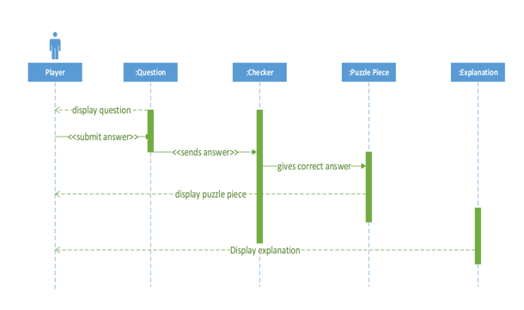
Figure 1. Correct Answer Sequence Diagram

Slide 6
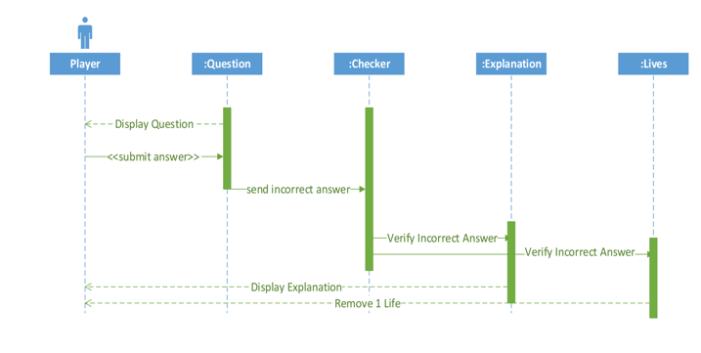
Figure 2. Incorrect Answer Sequence Diagram

Slide 7
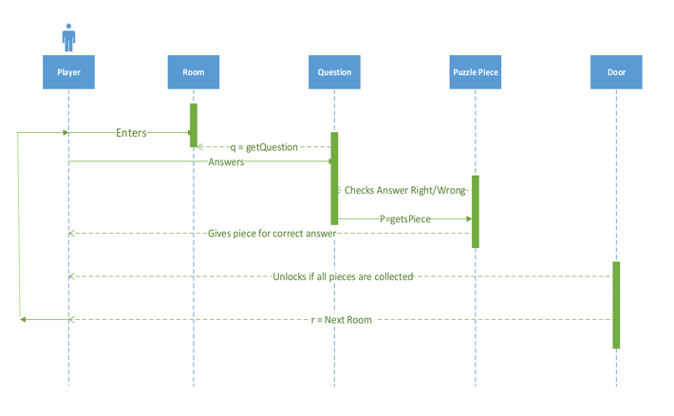
Figure 3. Movement and Interaction Sequence Diagram

Slide 8
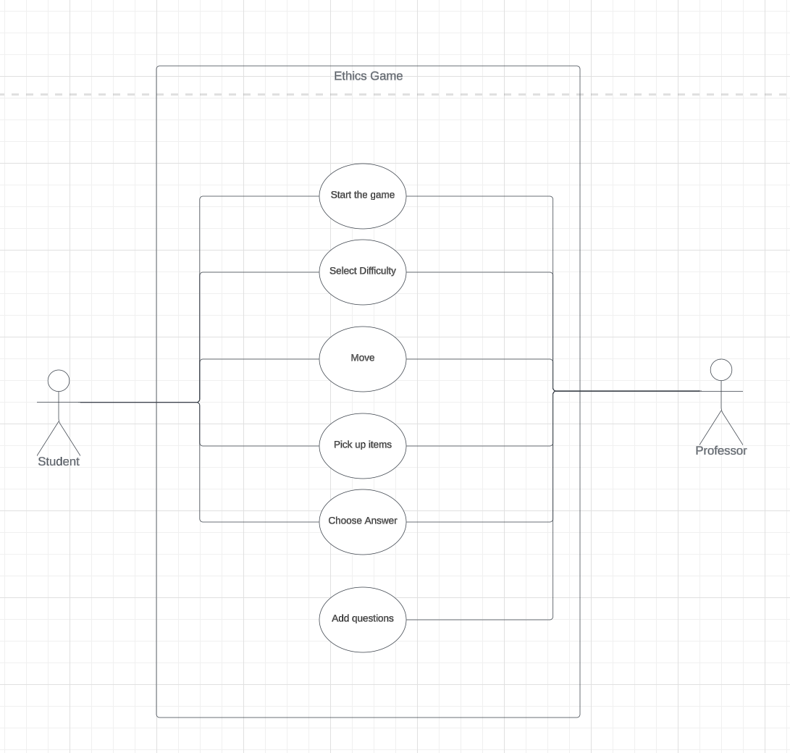
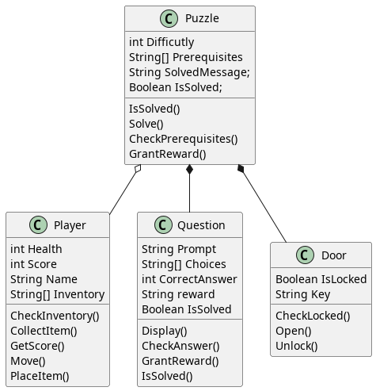
Figure 4. Use Case Diagram
Figure 5. Class Relationship Diagram

Slide 9
Demo
We will play our game live and show how it works.
We will also show the json file that allows the person who downloaded the game to change the questions.
The game is playable on Windows 10.
It’s not guaranteed to work on other platforms.

Slide 10
Test Report
Our test report focused on
Moving around the level.
Answering questions correctly, and incorrectly
Editing our questions.json file, and seeing what edits caused errors.

Slide 11
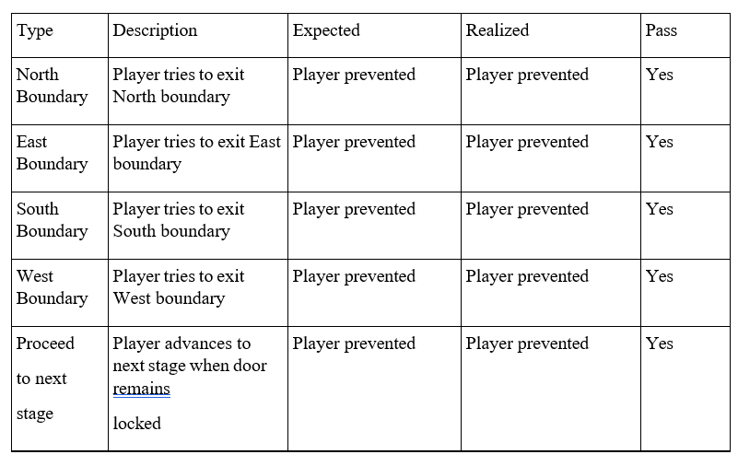
Figure 6. Exiting the Boundary testing.

Slide 12
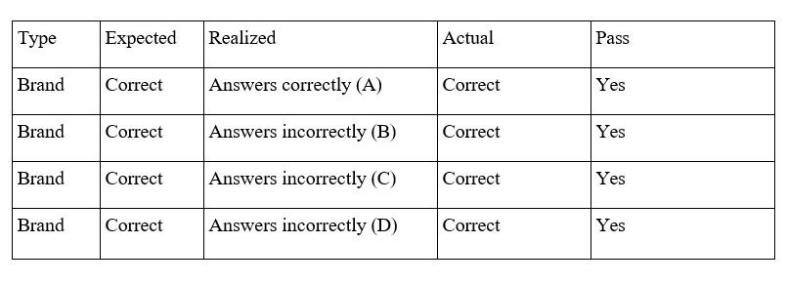
Figure 7. Answering Questions Testing

Slide 13
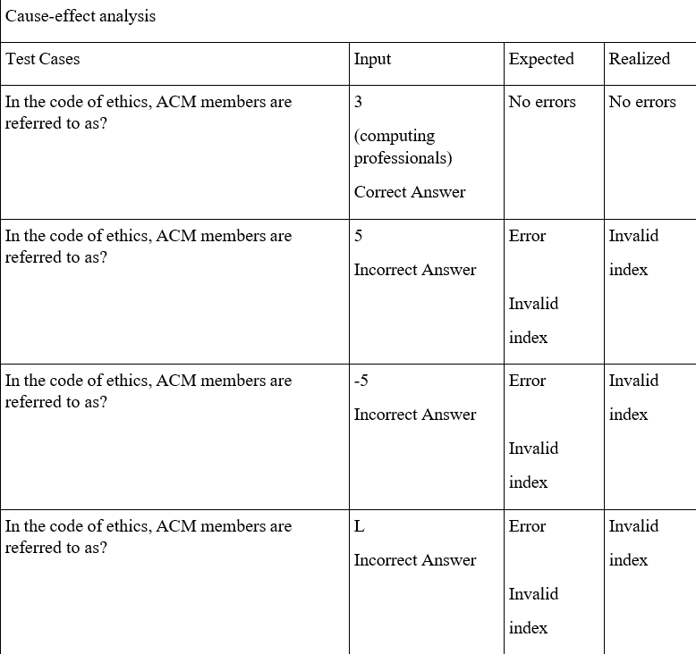
Figure 8. Edting questions.json file testing.

Slide 14
Deviations from Requirements
  The level editor was going to allow other aspects of the game to be edited.
  We reduced the number of levels from 10 to 2.
  We were originally going to have multiple difficulties.
  We changed the puzzle aspect of the game to a mini game aspect where you have to dodge enemies, and once you reach a certain score the door opens up.
  The ability to edit questions was originally going to be a feature accessible while playing the game, but instead we had to make it so that you have to edit a separate json file.

Slide 15
Deployment Issues
We had some issues with switching from Godot 3 to Godot 4.
In some of the tutorial videos we watched the creators of the videos used Godot 3, and some of the code was not compatible with Godot 4 and had to be modified.

Slide 16
Process used and Team Organization
  Who did what?
  Zane would lead when it came to discussing programming.
  Brayden would lead when it came to discussing documentation.
  Daniel would also lead when it came to discussing documentation
  Bishop would lead when it came to discussing diagrams.
  We would all assist each other as needed.
Process we used.
We started with the scrum process model and transitioned to the iterative process model.

Slide 17
What stayed the same, and what changed?
  The method for communication remained the same, that being using slack.
  The meeting place remained the same with us meeting in the library
  Progress checking remained the same with us sending our work to each other in slack or doing peer review in the library.
  Our process model deviated away from Scrum, and more towards Iterative.
  We switched from a centralized leadership style to a democratic style.

Slide 18
What we would do differently, and what we learned.
Start coding and experimenting with Godot sooner.
Come up with more questions.
Add more levels.
Add in difficulty settings.
Have a few iterations/prototypes of our game ready for the customer to test.
We learned a new programming language in GDScript, and we learned more about the process for game development.
We learned about the documentation and other tasks besides programming that software engineers have to go through.

